Slide 1


CS 5610 – Introduction to Cloud Computing

Slide 2
Project: Serverless Web Application (Employee Information Portal)
Developed by:
Sridivya Puttoju
700767142

Slide 3
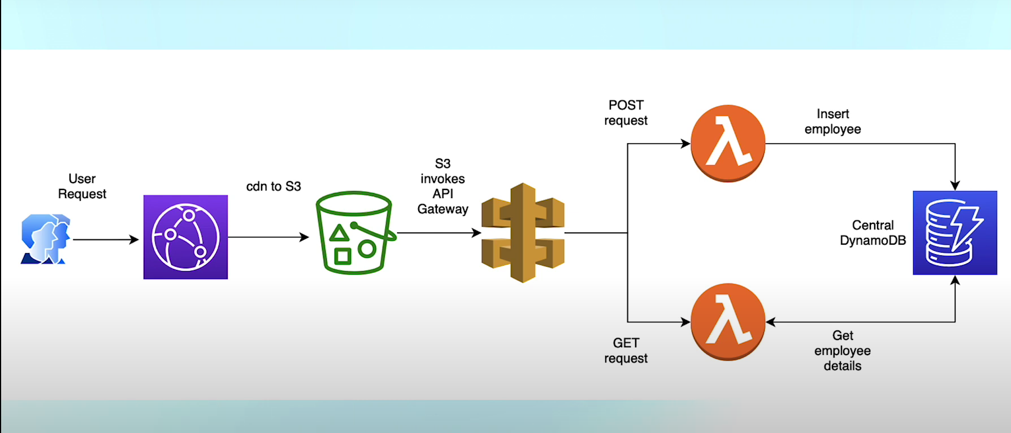
Serverless Web application:

Slide 4

S3 - Cloud Storage:
S3 - Simple Storage Service
Stores & retrieves any amount of data
Great for static website hosting
Highly durable and always available
Supports versioning and access control
Works with CloudFront for fast delivery
Data stored in buckets (like folders)

Slide 5
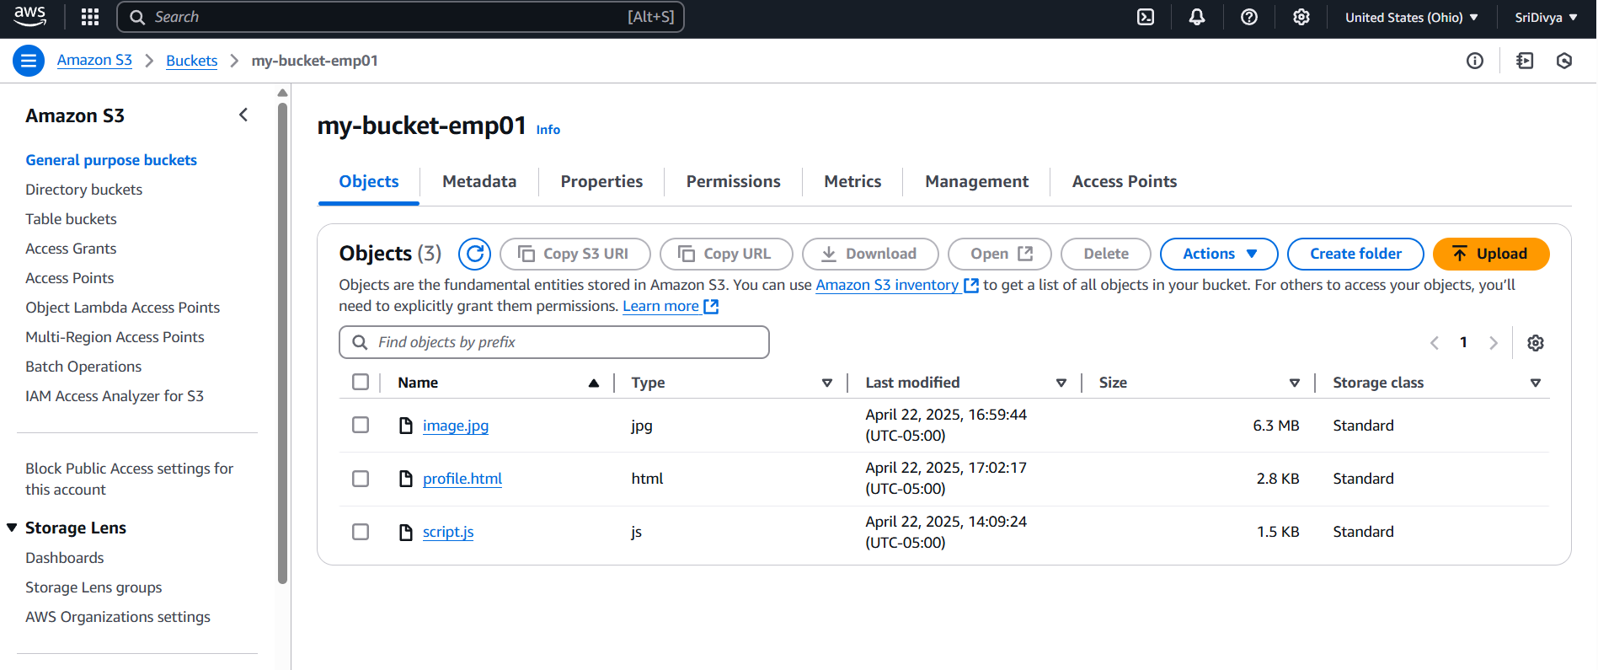

Slide 6
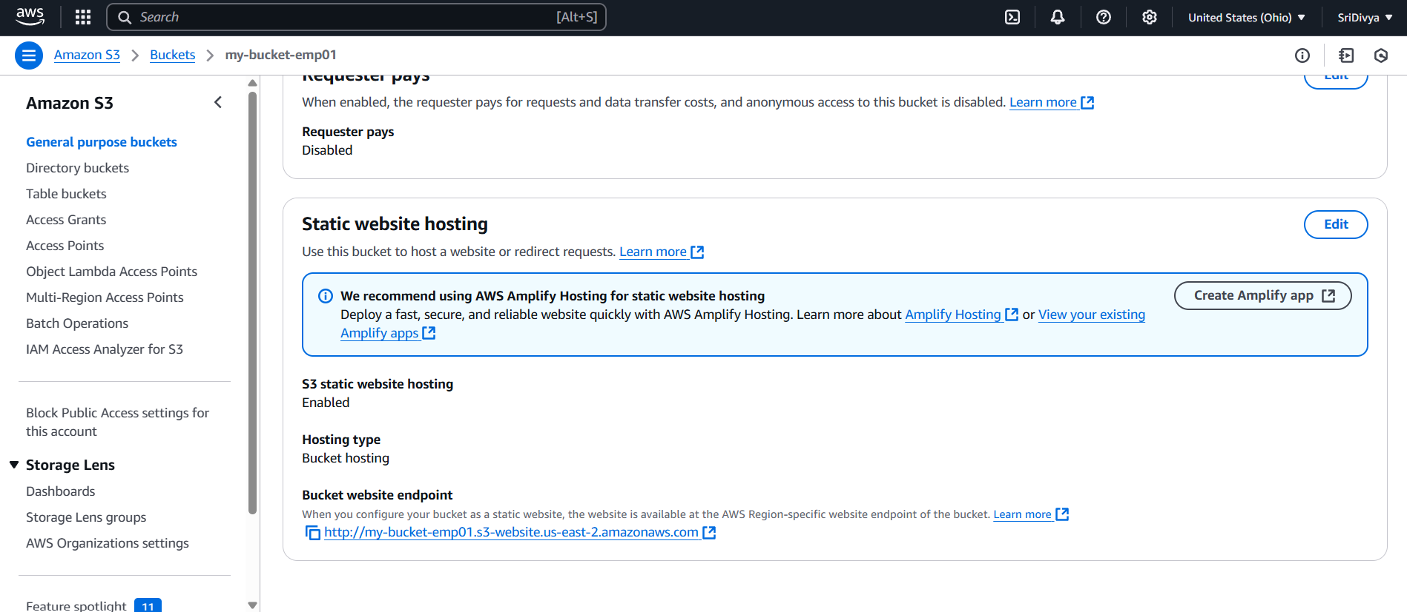

Slide 7

CloudFront:
A Content Delivery Network (CDN) by AWS
Delivers data, videos, websites, and APIs globally
Speeds up content by caching it at edge locations
Works with S3, Lambda, and API Gateway
Improves load time and reduces latency
Supports HTTPS for secure content delivery
Ideal for serving static and dynamic web content

Slide 8
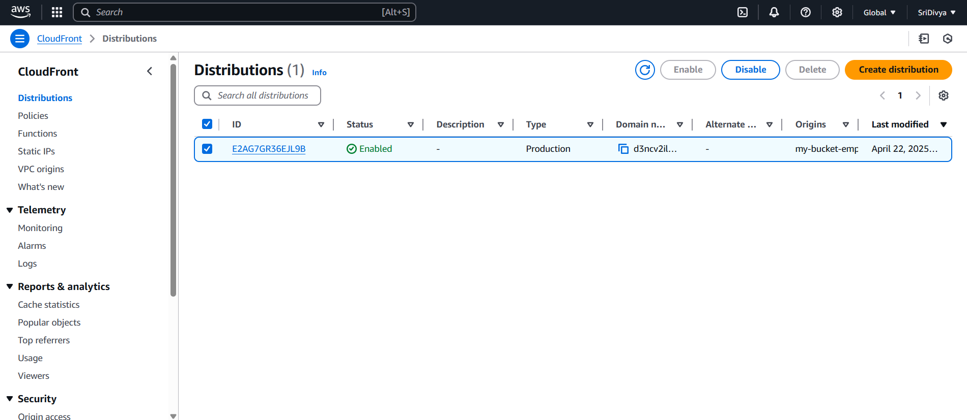

Slide 9
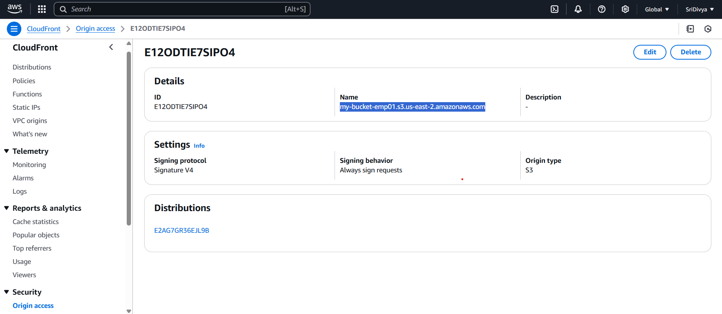

Slide 10

DynamoDB:
A fully managed NoSQL database by AWS
Stores data in key-value or document format
Delivers millisecond response times at any scale
Ideal for apps needing fast and flexible data access
Automatically scales with your traffic
Supports features like backup, restore, and TTL
Integrates easily with Lambda and API Gateway

Slide 11
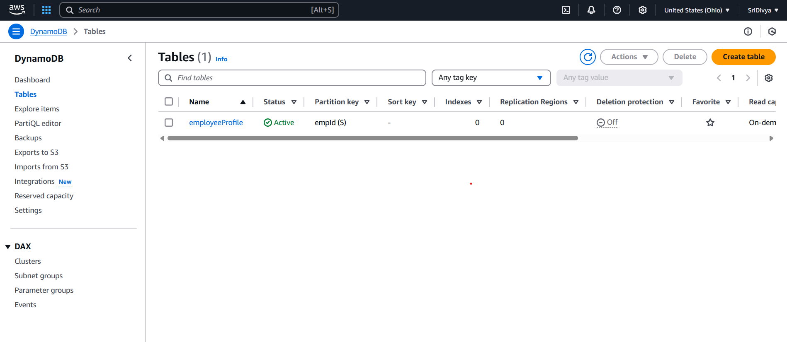

Slide 12
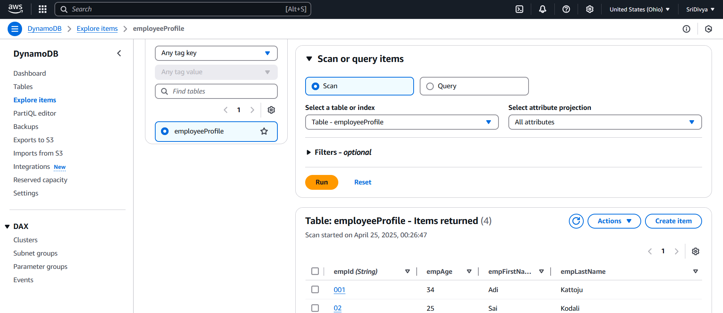

Slide 13

Lambda:
A serverless compute service by AWS
Runs code in response to events (e.g., API calls, uploads)
No server management needed — just write and deploy code
Supports multiple languages (Python, Node.js, Java, etc.)
Automatically scales based on request volume
Integrates easily with API Gateway, S3, and DynamoDB
Ideal for lightweight backend logic and automation

Slide 14
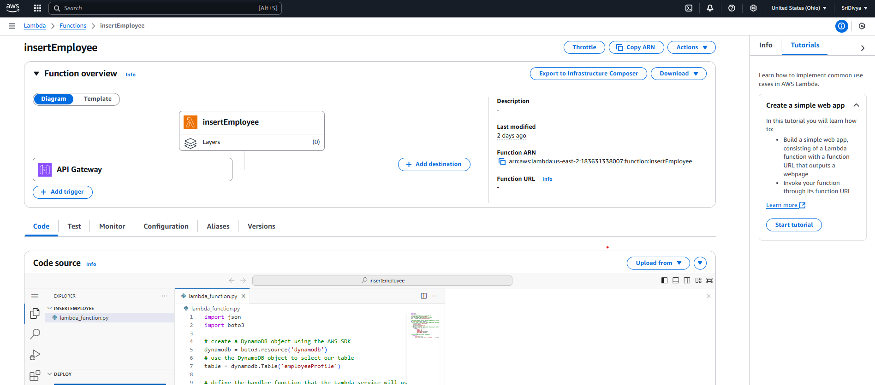

Slide 15
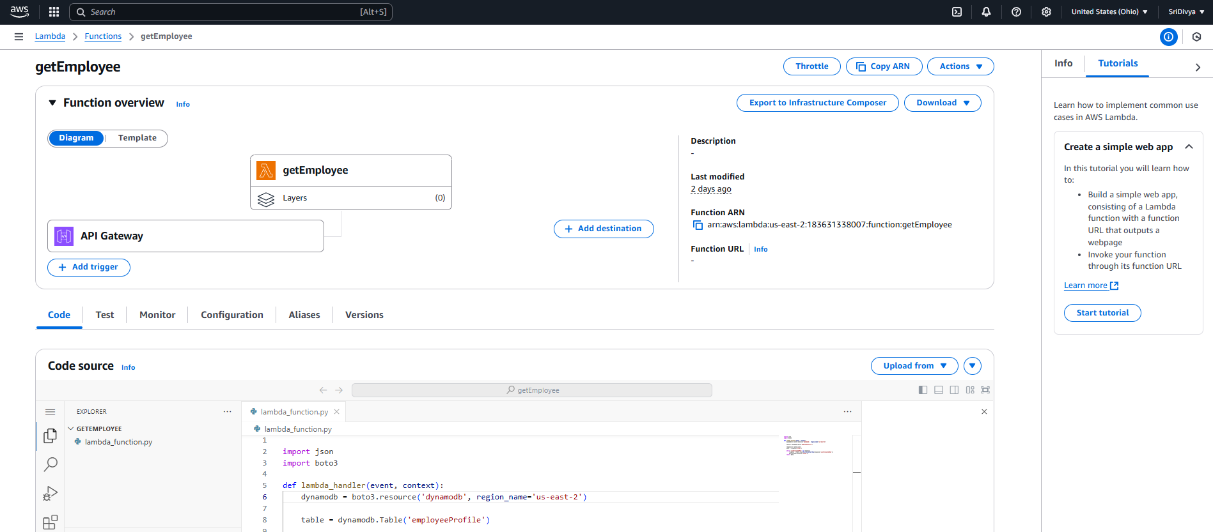

Slide 16

A fully managed service to create and manage APIs
Acts as a bridge between frontend and backend services
Handles HTTP requests and routes them to services like Lambda
Supports REST, HTTP, and WebSocket APIs
Built-in features for throttling, authorization, and monitoring
Scales automatically to handle any number of requests
Works seamlessly with Lambda, DynamoDB, and IAM
API Gateway:

Slide 17
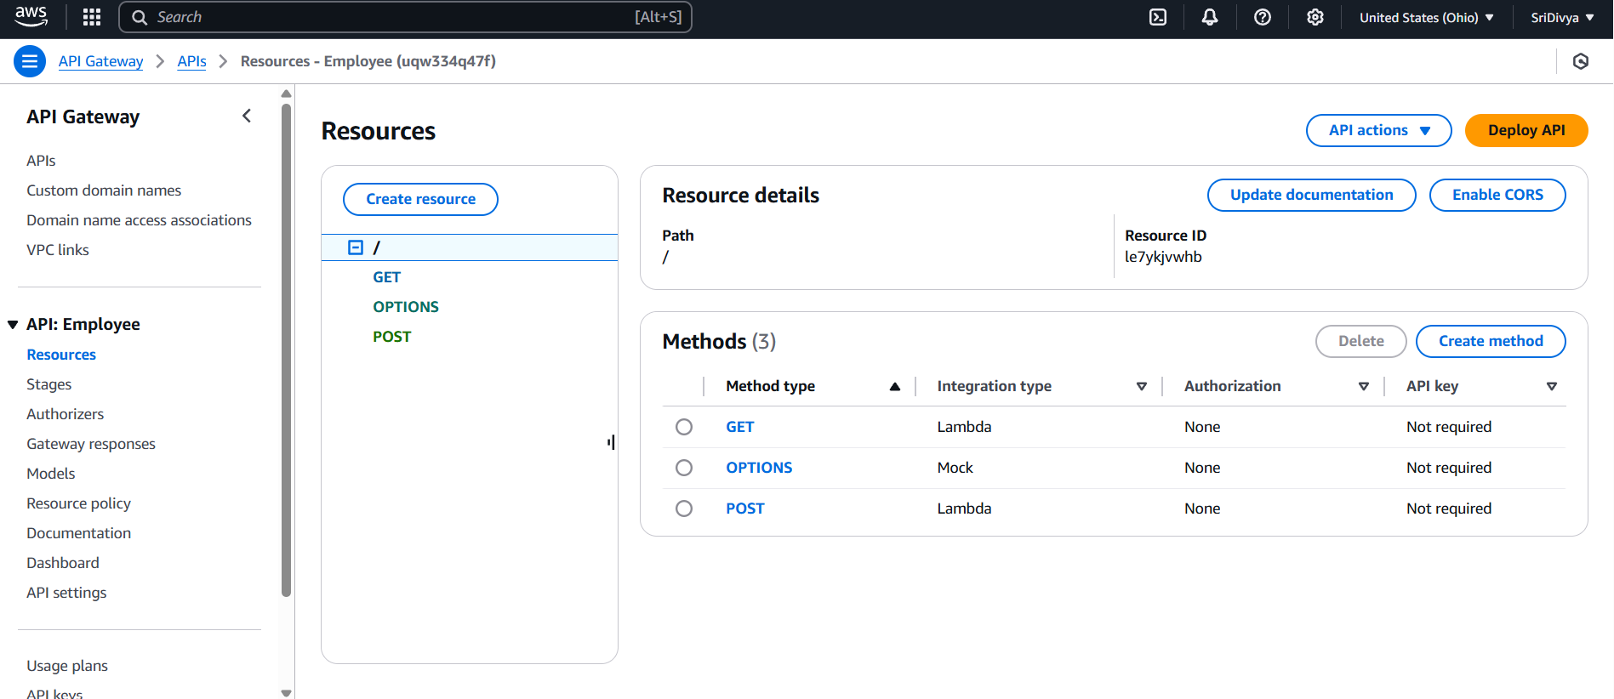

Slide 18
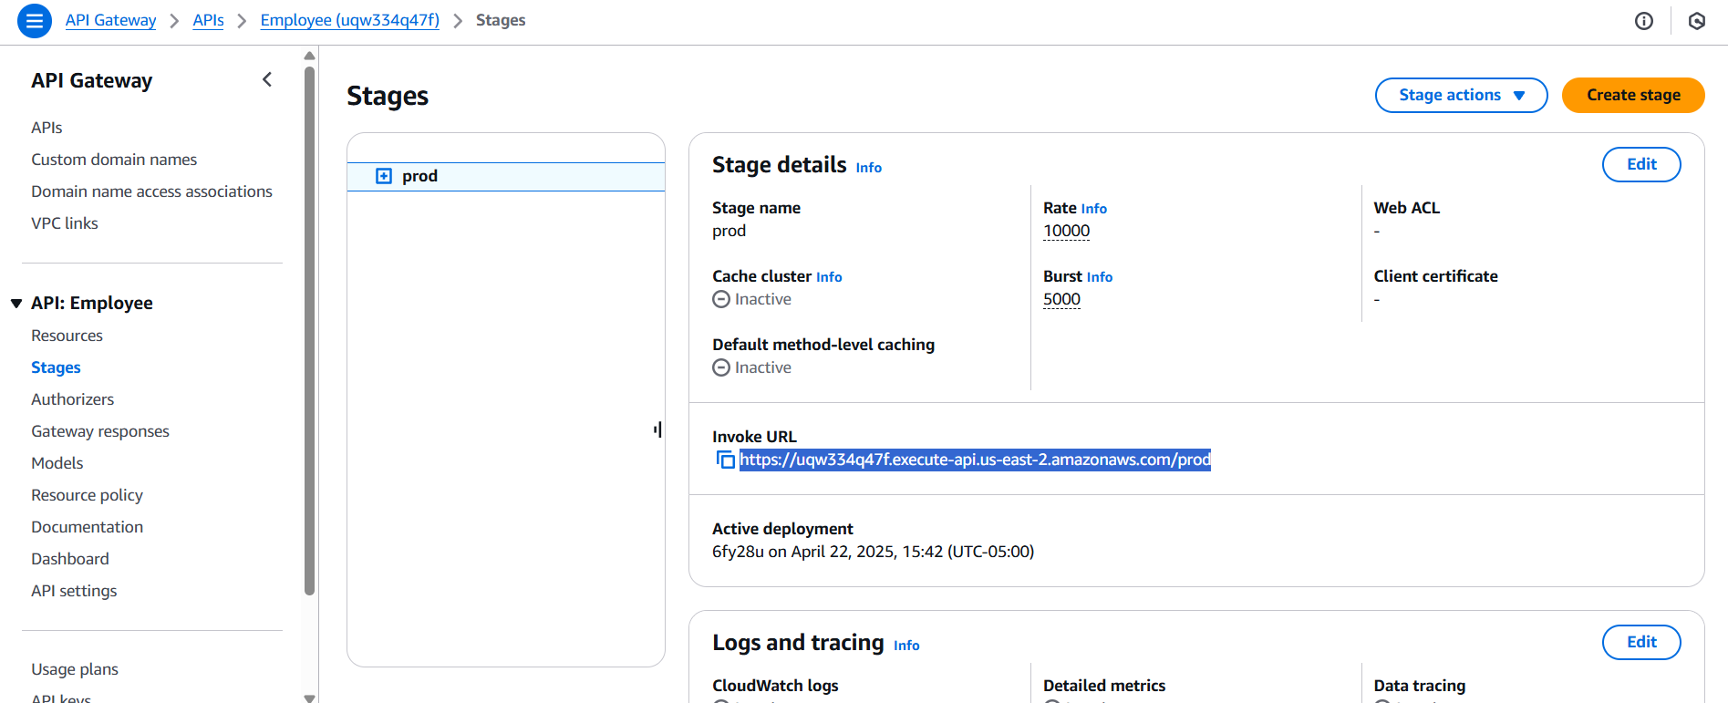

Slide 19
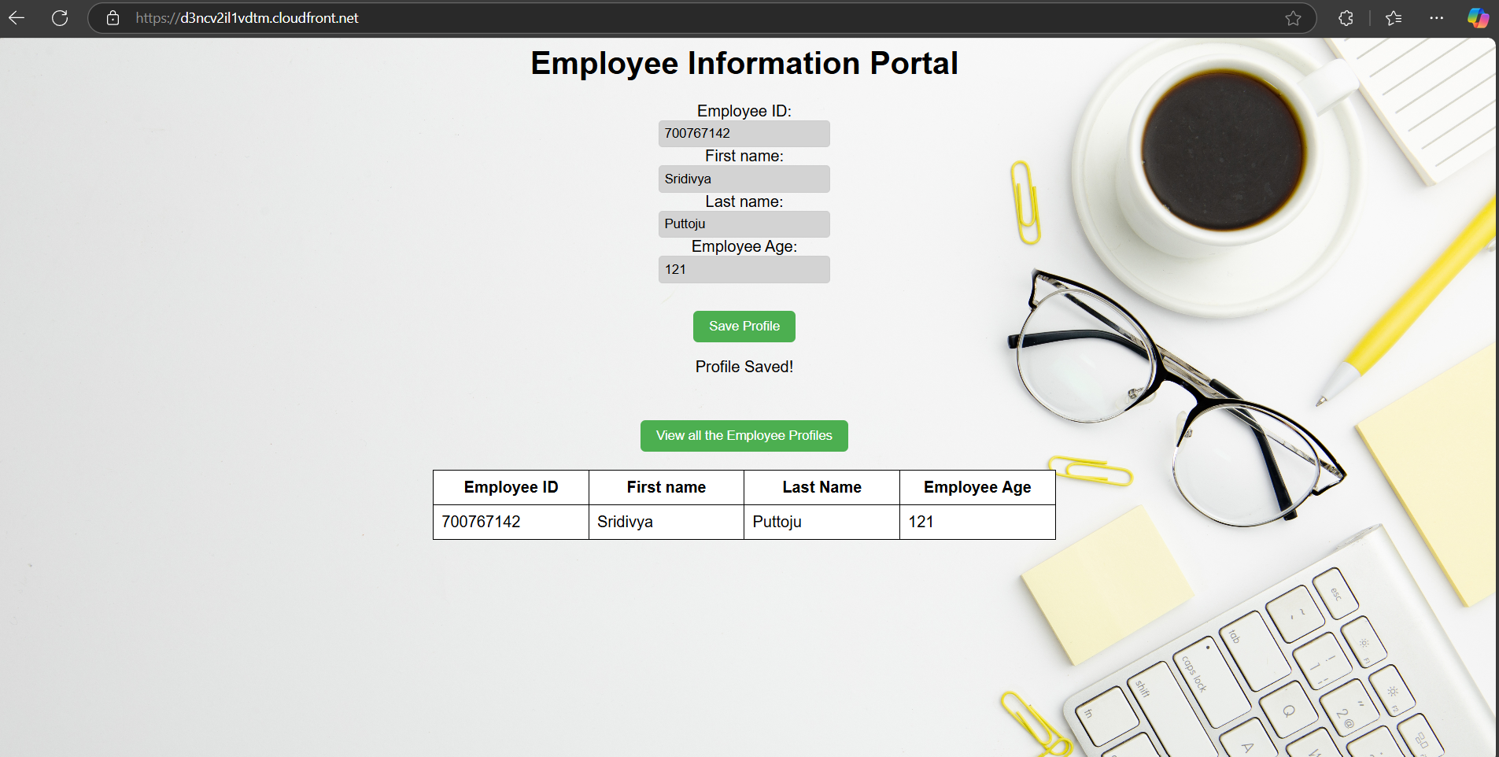

Slide 20
Thank You!!

